Slide 1

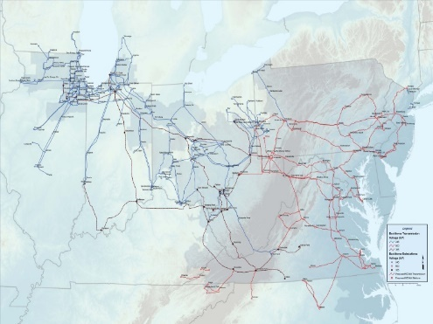
Energy Storage Package Introduction
Joe Durante
Princeton University
December 18/19, 2017
CASTLE Laboratory
Princeton University
http://www.castlelab.princeton.edu
Slide 1
Notes:
1

Slide 2
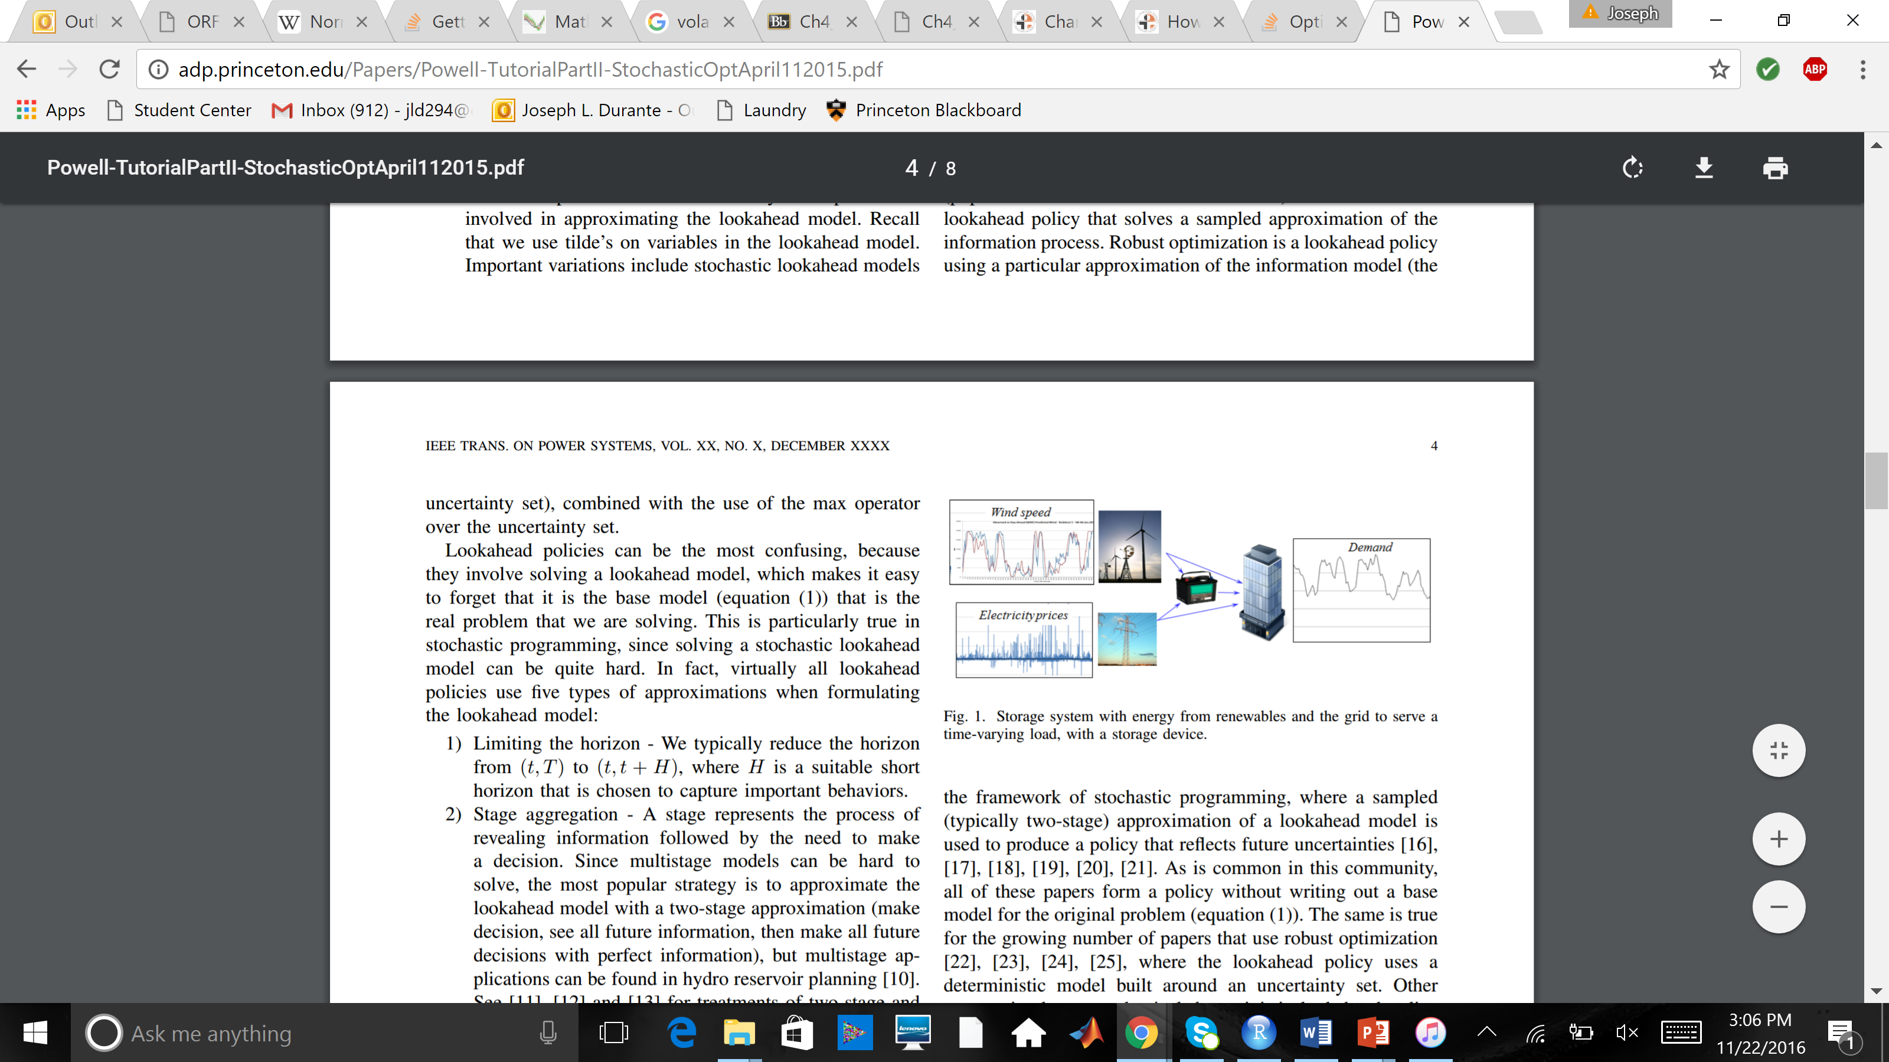
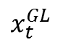
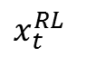
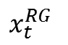
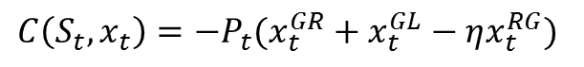
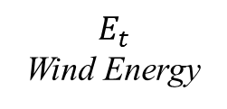
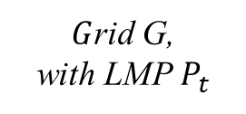
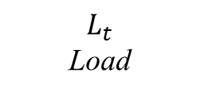
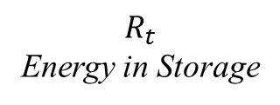
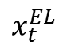
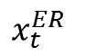
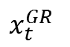
Energy Storage Problem Example
$$C\left(S_{t},x_{t}\right)=−P_{t}(x_{t}^{GR}+x_{t}^{GL}−ηx_{t}^{RG})$$
$$E_{t}$$
Wind Energy
$$x_{t}^{EL}$$
$$x_{t}^{ER}$$
$$R_{t}$$
Energy in Storage
$$x_{t}^{RL}$$
$$L_{t}$$
Load
$$x_{t}^{GR}$$
$$x_{t}^{RG}$$
$G$rid G,
with LMP $P_{t}$
$$x_{t}^{GL}$$

Slide 3
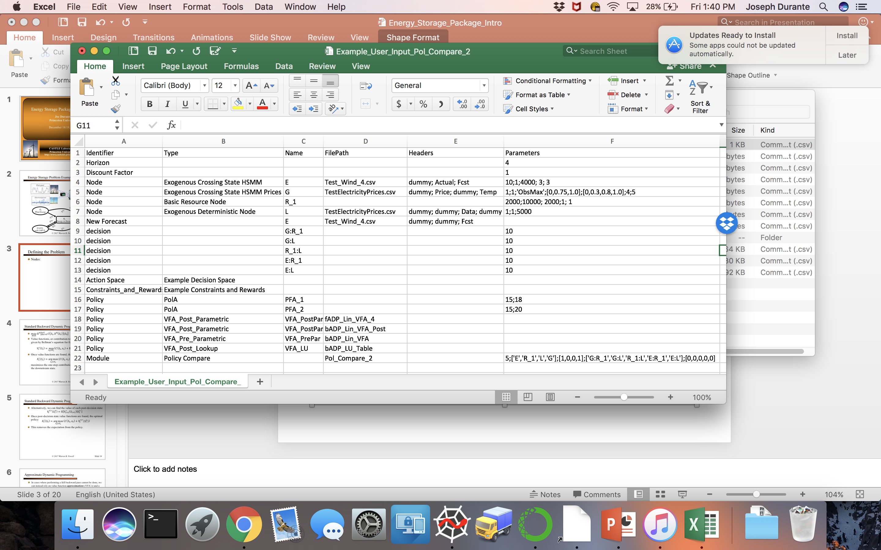
Example Input File
*Run by setting InputFile in main.py to path of this .csv file and then run main.py

Slide 4
Defining the Problem
Nodes:

Slide 5
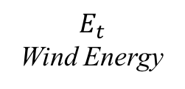
Defining the Problem
Nodes:
$$E_{t}$$
Wind Energy

Slide 6
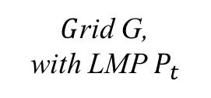
Defining the Problem
Nodes:
$$E_{t}$$
Wind Energy
$G$rid G,
with LMP $P_{t}$

Slide 7
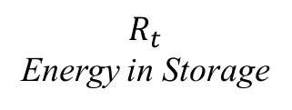
Defining the Problem
Nodes:
$$E_{t}$$
Wind Energy
$$R_{t}$$
Energy in Storage
$G$rid G,
with LMP $P_{t}$

Slide 8
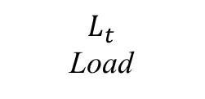
Defining the Problem
Nodes:
$$E_{t}$$
Wind Energy
$$R_{t}$$
Energy in Storage
$$L_{t}$$
Load
$G$rid G,
with LMP $P_{t}$

Slide 9
Defining the Problem
Decision Variables:
$$E_{t}$$
Wind Energy
$$R_{t}$$
Energy in Storage
$$L_{t}$$
Load
$G$rid G,
with LMP $P_{t}$

Slide 10
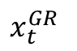
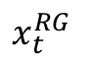
Defining the Problem
Decision Variables:
$$E_{t}$$
Wind Energy
$$R_{t}$$
Energy in Storage
$$L_{t}$$
Load
$$x_{t}^{GR}$$
$$x_{t}^{RG}$$
$G$rid G,
with LMP $P_{t}$

Slide 11
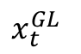
Defining the Problem
Decision Variables:
$$E_{t}$$
Wind Energy
$$R_{t}$$
Energy in Storage
$$L_{t}$$
Load
$$x_{t}^{GR}$$
$$x_{t}^{RG}$$
$G$rid G,
with LMP $P_{t}$
$$x_{t}^{GL}$$

Slide 12
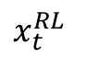
Defining the Problem
Decision Variables:
$$E_{t}$$
Wind Energy
$$R_{t}$$
Energy in Storage
$$x_{t}^{RL}$$
$$L_{t}$$
Load
$$x_{t}^{GR}$$
$$x_{t}^{RG}$$
$G$rid G,
with LMP $P_{t}$
$$x_{t}^{GL}$$

Slide 13
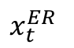
Defining the Problem
Decision Variables:
$$E_{t}$$
Wind Energy
$$x_{t}^{ER}$$
$$R_{t}$$
Energy in Storage
$$x_{t}^{RL}$$
$$L_{t}$$
Load
$$x_{t}^{GR}$$
$$x_{t}^{RG}$$
$G$rid G,
with LMP $P_{t}$
$$x_{t}^{GL}$$

Slide 14
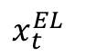
Defining the Problem
Decision Variables:
$$E_{t}$$
Wind Energy
$$x_{t}^{EL}$$
$$x_{t}^{ER}$$
$$R_{t}$$
Energy in Storage
$$x_{t}^{RL}$$
$$L_{t}$$
Load
$$x_{t}^{GR}$$
$$x_{t}^{RG}$$
$G$rid G,
with LMP $P_{t}$
$$x_{t}^{GL}$$

Slide 15
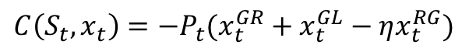
Defining the Problem
Contribution Function:
$$E_{t}$$
Wind Energy
$$C\left(S_{t},x_{t}\right)=−P_{t}(x_{t}^{GR}+x_{t}^{GL}−ηx_{t}^{RG})$$
$$x_{t}^{EL}$$
$$x_{t}^{ER}$$
$$R_{t}$$
Energy in Storage
$$x_{t}^{RL}$$
$$L_{t}$$
Load
$$x_{t}^{GR}$$
$$x_{t}^{RG}$$
$G$rid G,
with LMP $P_{t}$
$$x_{t}^{GL}$$

Slide 16
Defining the Problem
Feasible Decision Space (if needed):
$$E_{t}$$
Wind Energy
$$C\left(S_{t},x_{t}\right)=−P_{t}(x_{t}^{GR}+x_{t}^{GL}−ηx_{t}^{RG})$$
$$x_{t}^{EL}$$
$$x_{t}^{ER}$$
$$R_{t}$$
Energy in Storage
$$x_{t}^{RL}$$
$$L_{t}$$
Load
$$x_{t}^{GR}$$
$$x_{t}^{RG}$$
$G$rid G,
with LMP $P_{t}$
$$x_{t}^{GL}$$

Slide 17
Defining the Problem
Transition Function(s):
Both pre- to post- and post- to pre- decision state transition functions must be defined for each node in its Python class
$$E_{t}$$
Wind Energy
$$C\left(S_{t},x_{t}\right)=−P_{t}(x_{t}^{GR}+x_{t}^{GL}−ηx_{t}^{RG})$$
$$x_{t}^{EL}$$
$$x_{t}^{ER}$$
$$R_{t}$$
Energy in Storage
$$x_{t}^{RL}$$
$$L_{t}$$
Load
$$x_{t}^{GR}$$
$$x_{t}^{RG}$$
$G$rid G,
with LMP $P_{t}$
$$x_{t}^{GL}$$

Slide 18
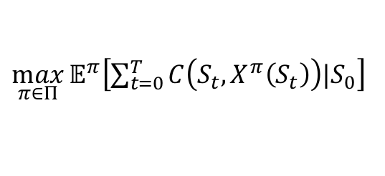
Defining the Problem
Time Horizon:
$\max_{π∈Π}{𝔼^{π}\left[\sum_{t=0}^{T}{C\left(S_{t},X^{π}\left(S_{t}\right)\right)|S_{0}}\right]}$
$$E_{t}$$
Wind Energy
$$C\left(S_{t},x_{t}\right)=−P_{t}(x_{t}^{GR}+x_{t}^{GL}−ηx_{t}^{RG})$$
$$x_{t}^{EL}$$
$$x_{t}^{ER}$$
$$R_{t}$$
Energy in Storage
$$x_{t}^{RL}$$
$$L_{t}$$
Load
$$x_{t}^{GR}$$
$$x_{t}^{RG}$$
$G$rid G,
with LMP $P_{t}$
$$x_{t}^{GL}$$

Slide 19
Policies
Now we look to find the best policy
$\max_{π∈Π}{𝔼^{π}\left[\sum_{t=0}^{T}{C\left(S_{t},X^{π}\left(S_{t}\right)\right)|S_{0}}\right]}$
$$E_{t}$$
Wind Energy
$$C\left(S_{t},x_{t}\right)=−P_{t}(x_{t}^{GR}+x_{t}^{GL}−ηx_{t}^{RG})$$
$$x_{t}^{EL}$$
$$x_{t}^{ER}$$
$$R_{t}$$
Energy in Storage
$$x_{t}^{RL}$$
$$L_{t}$$
Load
$$x_{t}^{GR}$$
$$x_{t}^{RG}$$
$G$rid G,
with LMP $P_{t}$
$$x_{t}^{GL}$$

Slide 20
Policies
Four Classes of Policies:
PFAs
Map state directly to action, use policy search to tune parameters
CFAs
Maximize some analytic function, use policy search to tune parameters
VFAs
Maximize one-step contribution plus the approximate value of being in a downstream state, use ADP to find VFAs
DLAs
Optimize over a planning horizon using a deterministic or stochastic approximation of the future

Slide 21
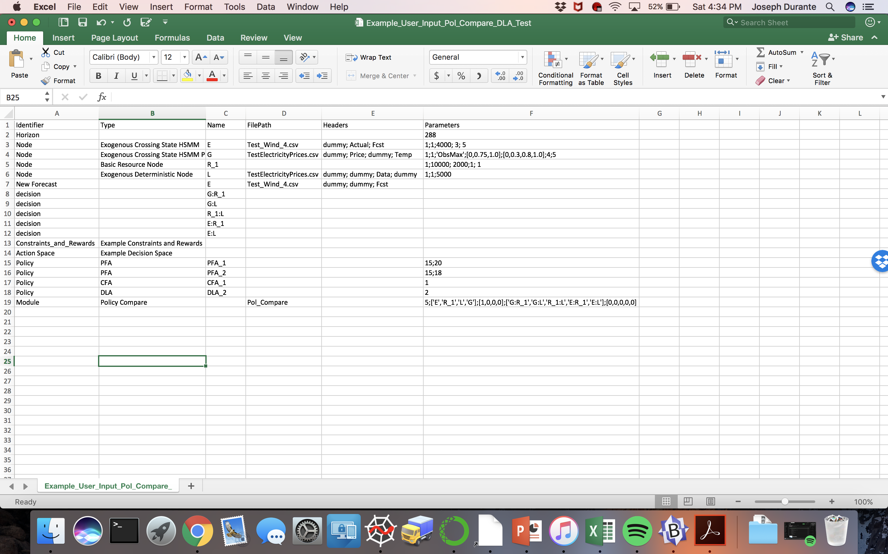
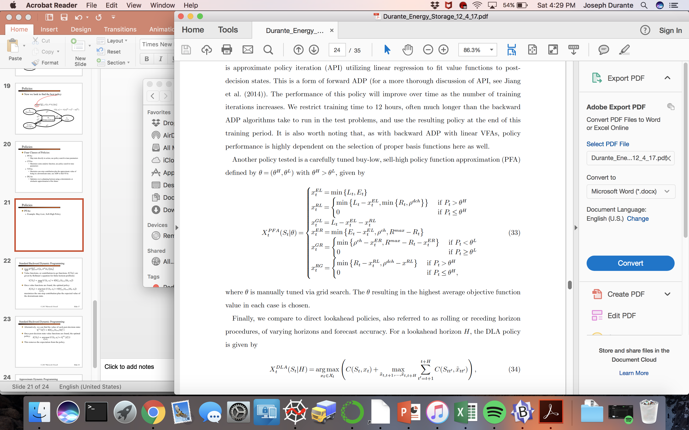
Policies
PFAs:
Example: Buy-Low, Sell-High Policy

Slide 22
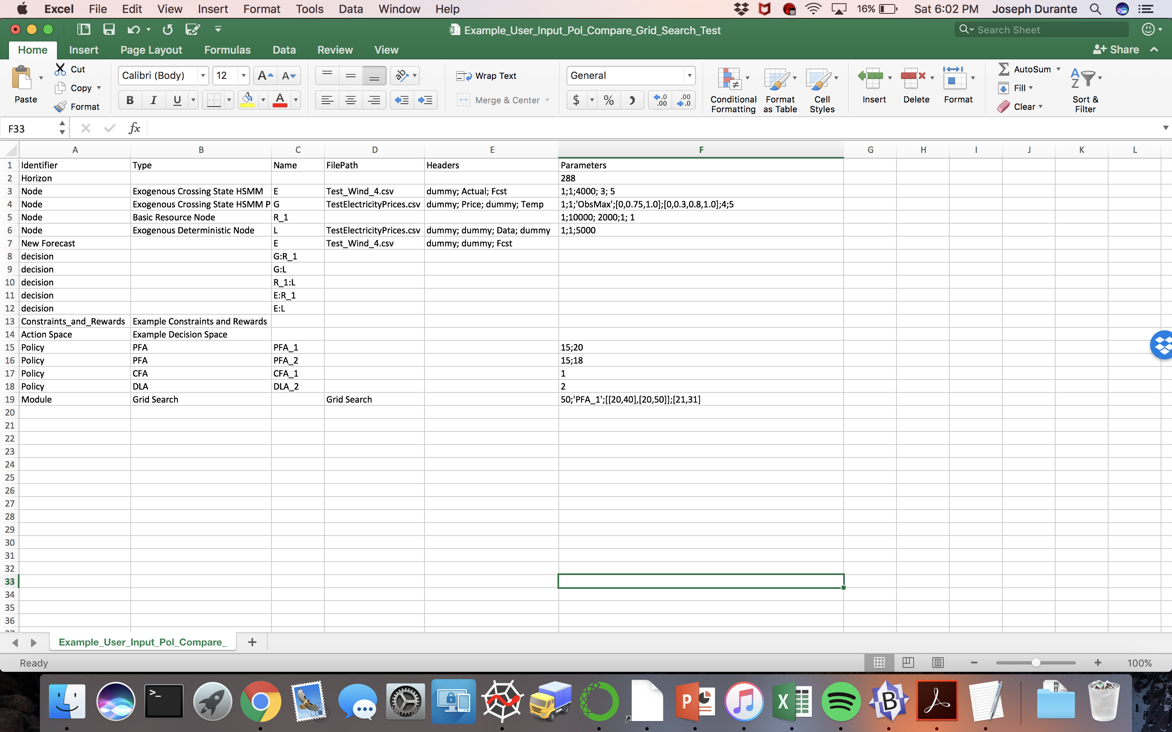
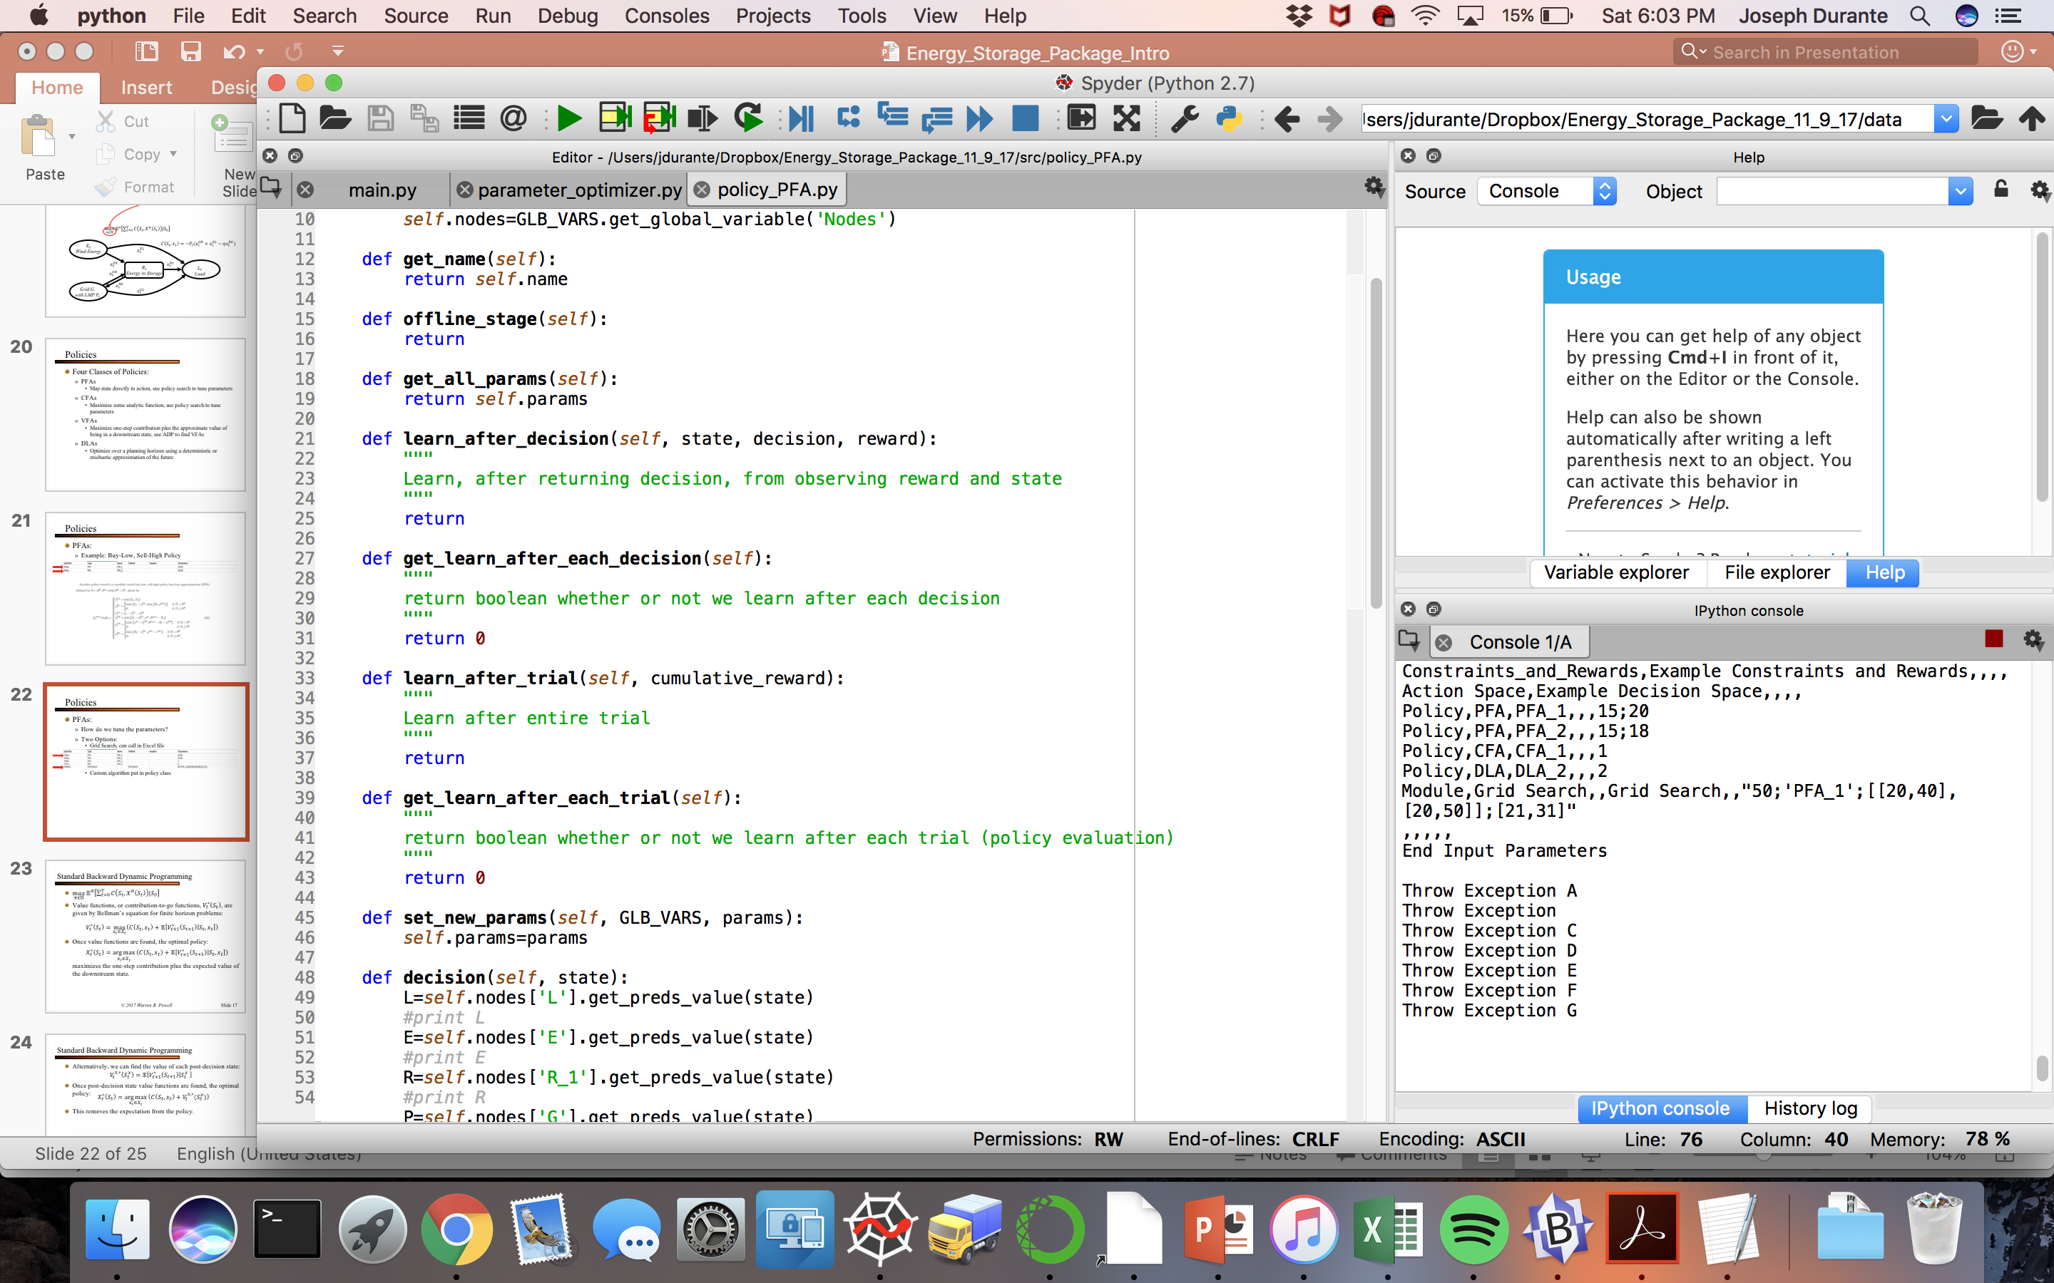
Policies
PFAs:
How do we tune the parameters?
Two Options:
Grid Search, can call in Excel file
Custom algorithm, put in policy class

Slide 23
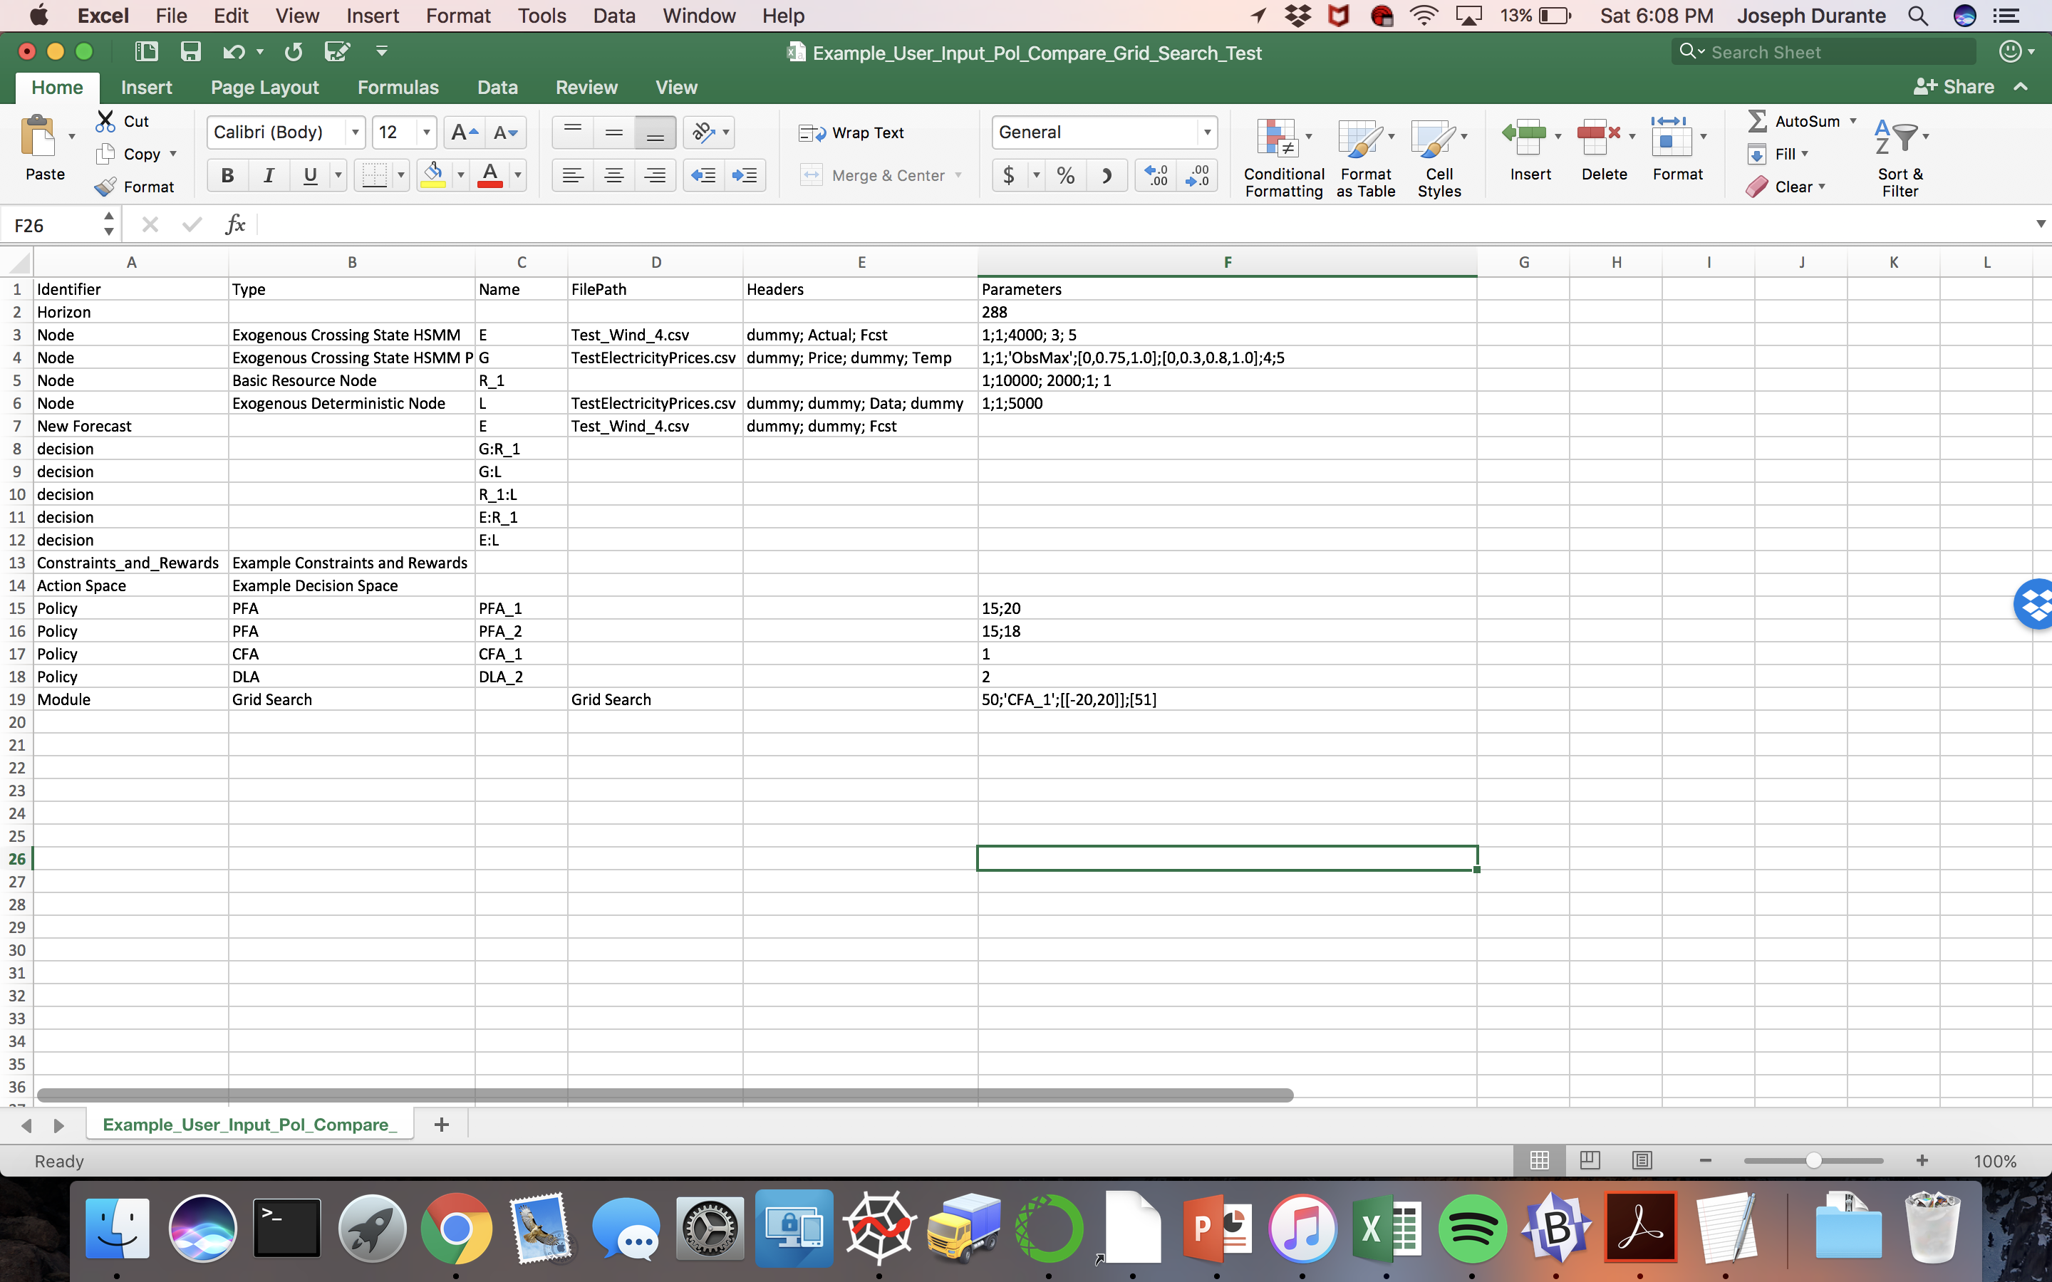
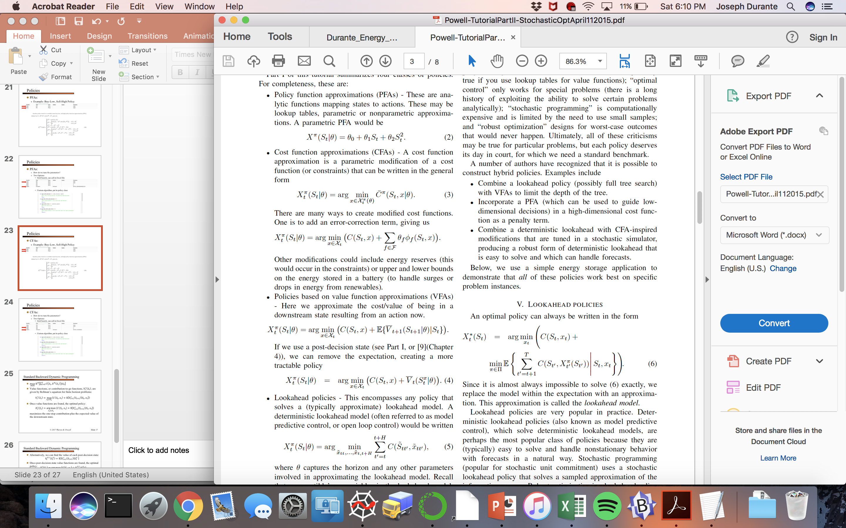
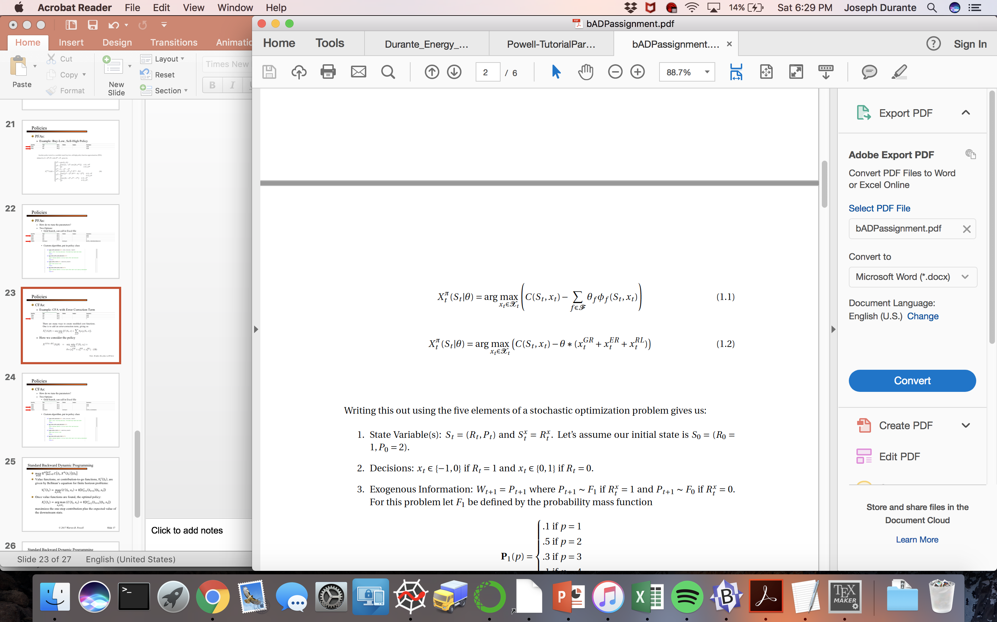
Policies
CFAs:
Example: CFA with Error Correction Term
Here we consider the policy

Slide 24
Policies
CFAs:
How do we tune the parameters?
Two Options:
Grid Search, can call in Excel file
Custom algorithm, put in policy class

Slide 25
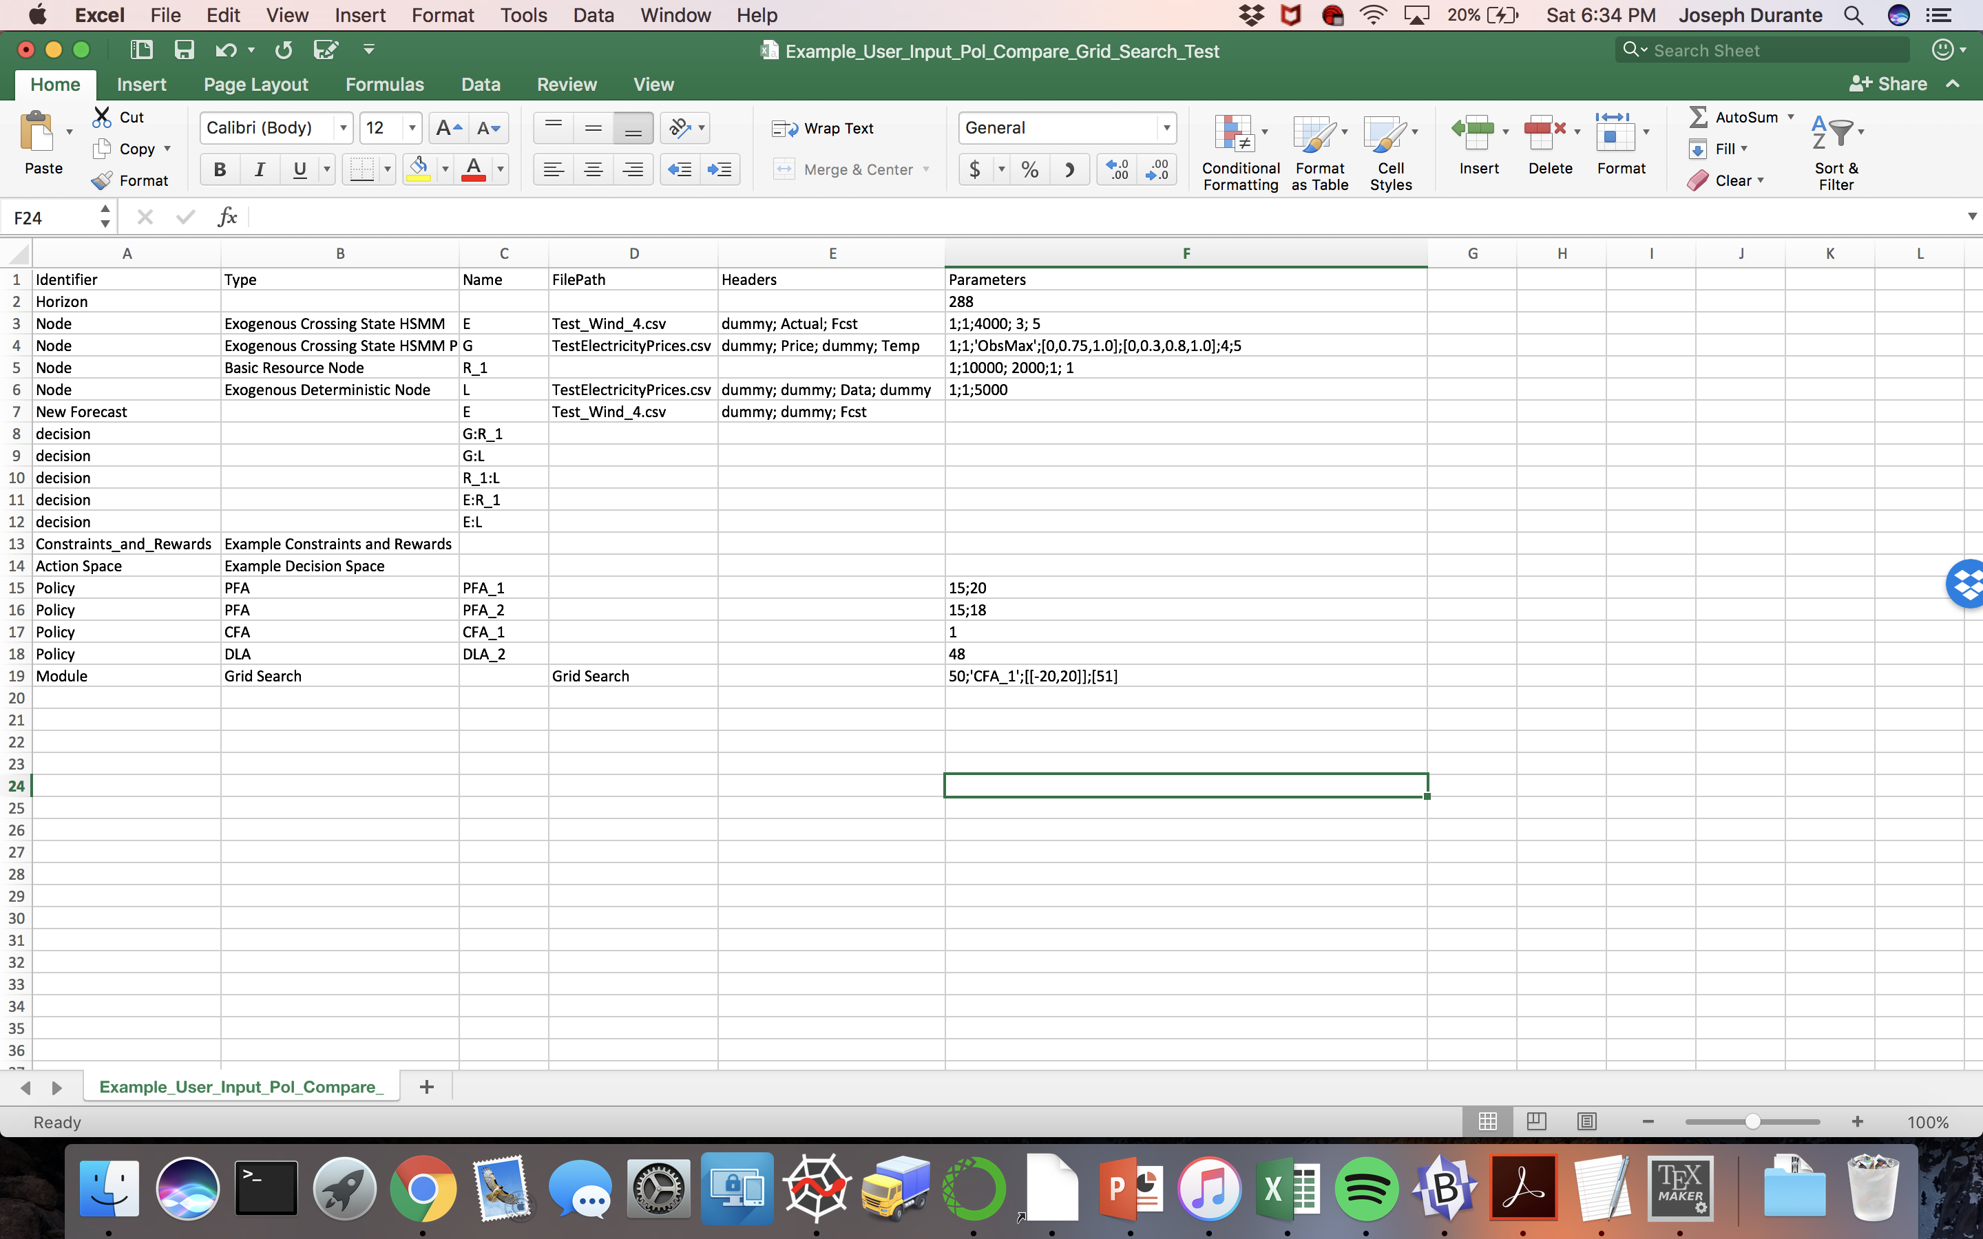
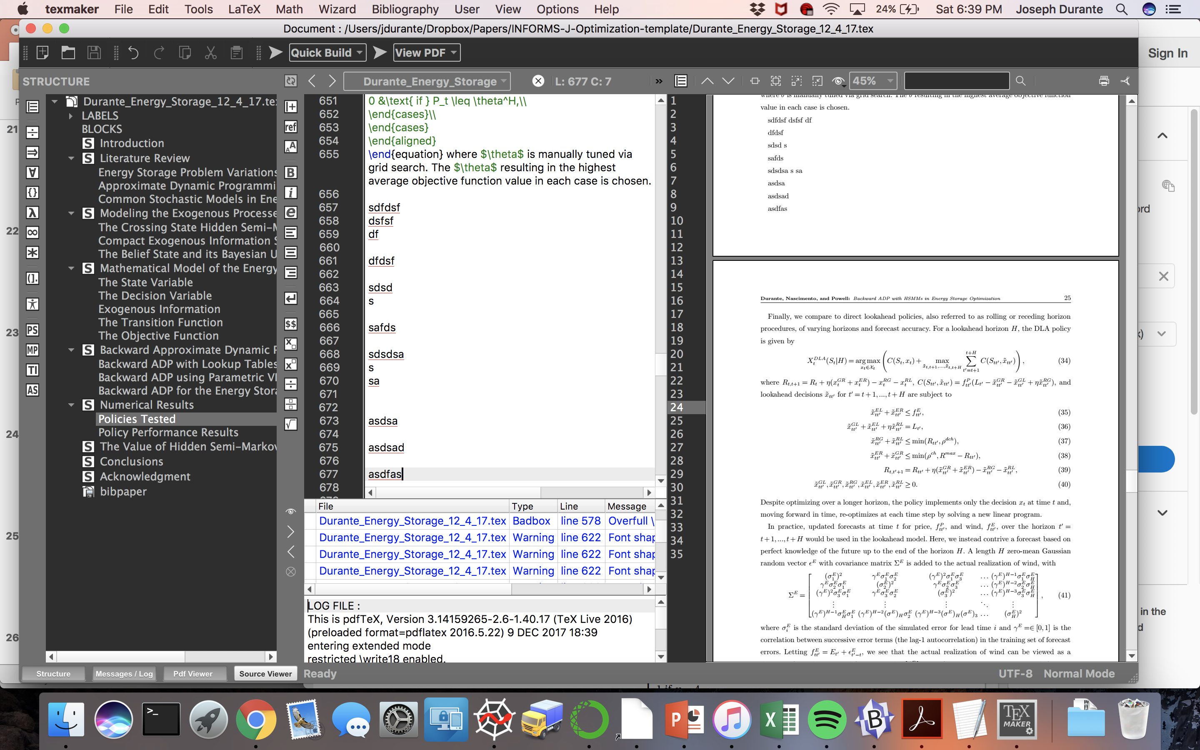
Policies
DLAs:
Example: Rolling Horizon policy based on point forecasts

Slide 26
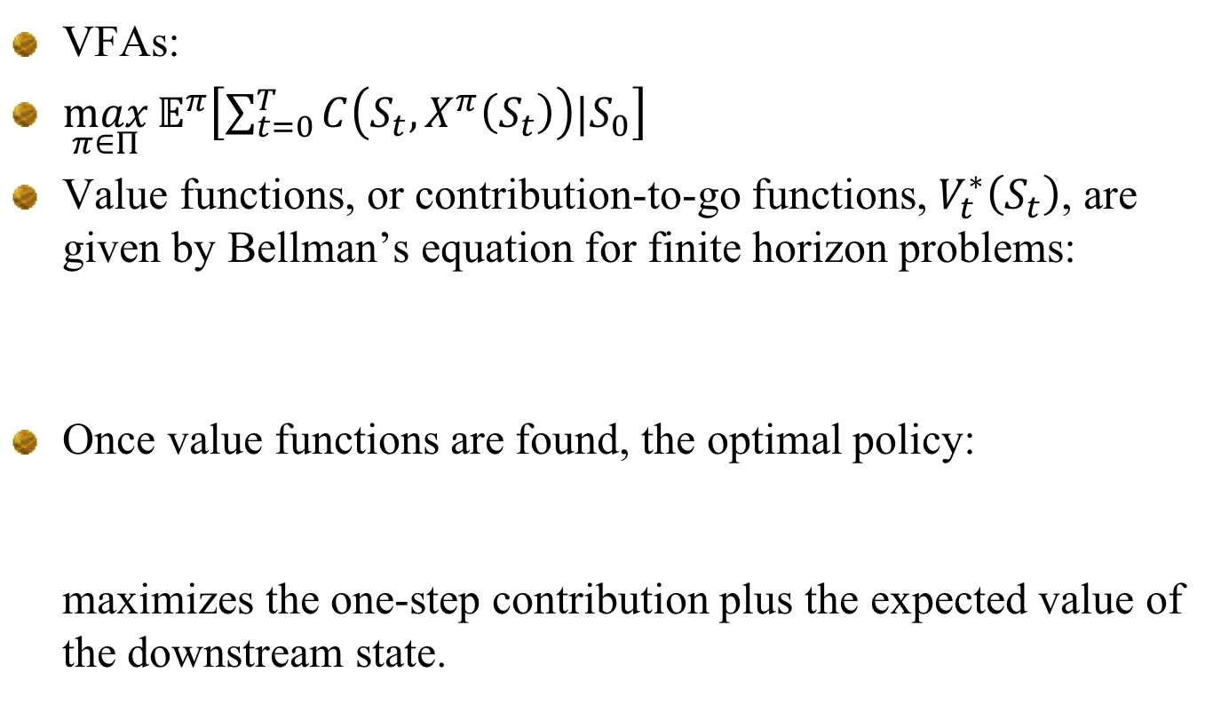
Policies
VFAs:
$\max_{π∈Π}{𝔼^{π}\left[\sum_{t=0}^{T}{C\left(S_{t},X^{π}\left(S_{t}\right)\right)|S_{0}}\right]}$
Value functions, or contribution-to-go functions, $V_{t}^{∗}\left(S_{t}\right)$, are given by Bellman’s equation for finite horizon problems:
Once value functions are found, the optimal policy: maximizes the one-step contribution plus the expected value of the downstream state.
$$V_{t}^{∗}\left(S_{t}\right)=\max_{x_{t}∈𝒳_{t}}\left(C\left(S_{t},x_{t}\right)+𝔼\left[V_{t+1}^{∗}\left(S_{t+1}\right) | S_{t},x_{t}\right]\right)$$
$$X_{t}^{∗}\left(S_{t}\right)=\underset{x_{t}∈𝒳_{t}}{\arg{max}}\left(C\left(S_{t},x_{t}\right)+𝔼\left[V_{t+1}^{∗}\left(S_{t+1}\right) | S_{t},x_{t}\right]\right)$$
Notes:
Given terminal reward $V_{T}\left(S_{T}\right)$ for each terminal state $S_{T}$, if computationally tractable, an optimal policy can be found using vanilla backward dynamic programming to find value functions, or contribution-to-go functions, $V_{t}^{∗}\left(S_{t}\right)$, for each possible system state.

Slide 27
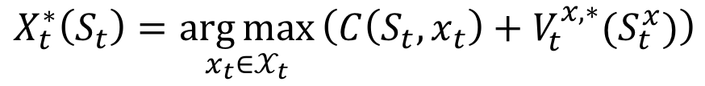
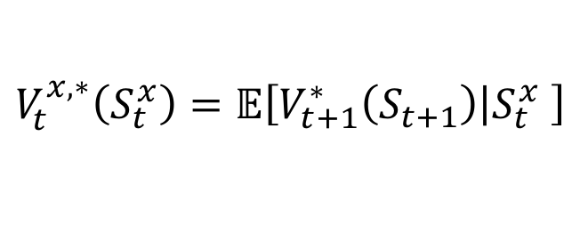
Policies
VFAs:
Alternatively, we can find the value of each post-decision state:
Once post-decision state value functions are found, the optimal policy:
This removes the expectation from the policy.
$$V_{t}^{x,∗}\left(S_{t}^{x}\right)=𝔼\left[V_{t+1}^{∗}\left(S_{t+1}\right) | S_{t}^{x} \right]$$
$$X_{t}^{∗}\left(S_{t}\right)=\underset{x_{t}∈𝒳_{t}}{\arg{max}}\left(C\left(S_{t},x_{t}\right)+V_{t}^{x,∗}(S_{t}^{x})\right)$$

Slide 28
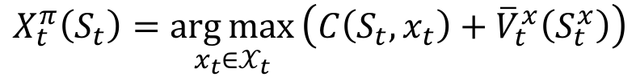
Policies
VFAs:
In cases where performing a full backward pass cannot be done, we can instead rely on value function approximations (VFA’s) and a VFA-based policy:
Alternatively, we can fit value functions approximations to post-decision states instead, giving the policy:
Approximate dynamic programming is used to find the value functions
$$X_{t}^{π}\left(S_{t}\right)=\underset{x_{t}∈𝒳_{t}}{\arg{max}}\left(C\left(S_{t},x_{t}\right)+𝔼\left[{\overline{V}}_{t+1}\left(S_{t+1}\right) | S_{t},x_{t}\right]\right)$$
$$X_{t}^{π}\left(S_{t}\right)=\underset{x_{t}∈𝒳_{t}}{\arg{max}}\left(C\left(S_{t},x_{t}\right)+{\overline{V}}_{t}^{x}\left(S_{t}^{x}\right)\right)$$
Notes:
${\overline{V}}_{t+1}\left(S_{t+1}\right)$ is some approximation of the value of the downstream states
${\overline{V}}_{t}^{x}\left(S_{t}^{x}\right)$ serves as an approximation of $𝔼\left[V_{t+1}^{∗}\left(S_{t+1}\right) | S_{t},x_{t}\right]$

Slide 29
Policies
VFAs:
In cases where performing a full backward pass cannot be done, we can instead rely on value function approximations (VFA’s) and a VFA-based policy:
Alternatively, we can fit value functions approximations to post-decision states instead, giving the policy:
Approximate dynamic programming is used to fit the value functions approximations
$$X_{t}^{π}\left(S_{t}\right)=\underset{x_{t}∈𝒳_{t}}{\arg{max}}\left(C\left(S_{t},x_{t}\right)+𝔼\left[{\overline{V}}_{t+1}\left(S_{t+1}\right) | S_{t},x_{t}\right]\right)$$
$$X_{t}^{π}\left(S_{t}\right)=\underset{x_{t}∈𝒳_{t}}{\arg{max}}\left(C\left(S_{t},x_{t}\right)+{\overline{V}}_{t}^{x}\left(S_{t}^{x}\right)\right)$$
Notes:
${\overline{V}}_{t+1}\left(S_{t+1}\right)$ is some approximation of the value of the downstream states
${\overline{V}}_{t}^{x}\left(S_{t}^{x}\right)$ serves as an approximation of $𝔼\left[V_{t+1}^{∗}\left(S_{t+1}\right) | S_{t},x_{t}\right]$

Slide 30
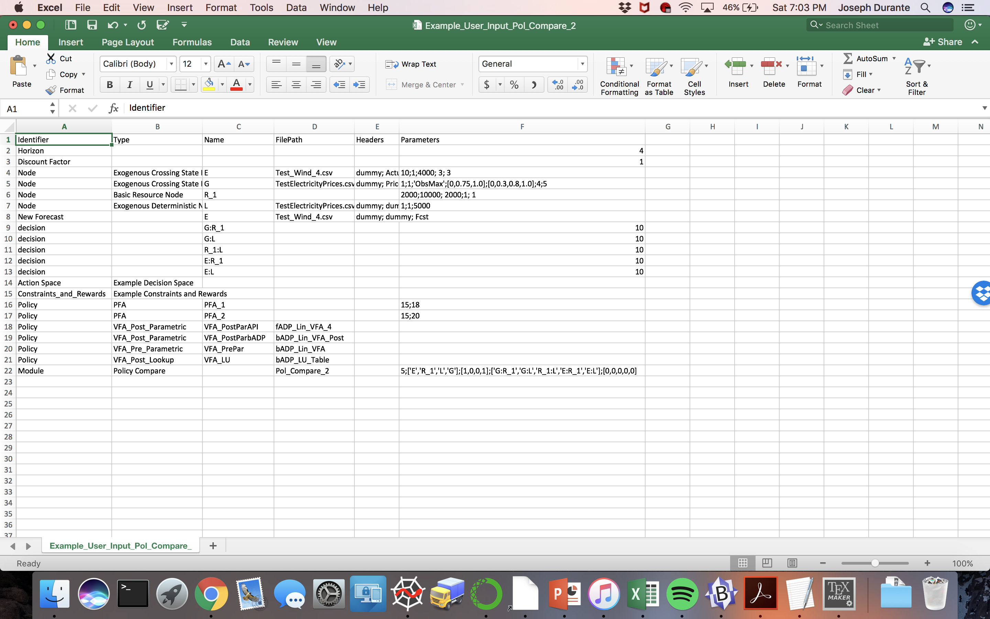
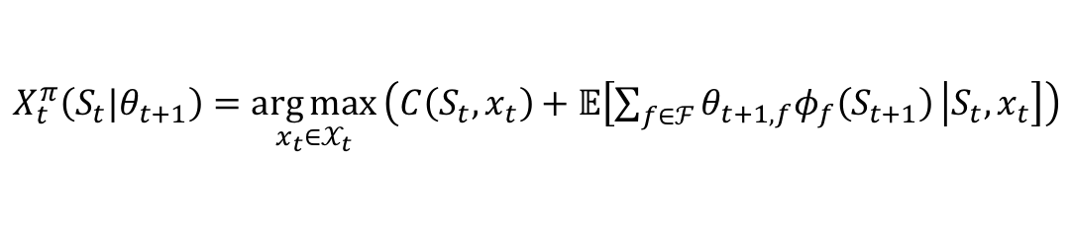
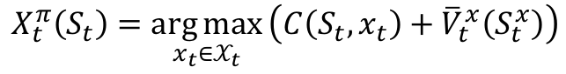
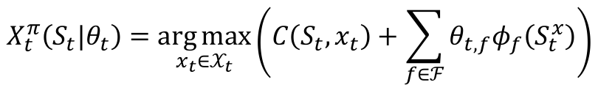
Policies
VFAs: Three policies available for different VFA types
Linear model (linear in the parameters) for pre-decision states
Lookup table for post-decision states
Linear model (linear in the parameters) for post-decision states
C
C
VFAs found in FilePath!
A
B
A
$$X_{t}^{π}\left(S_{t}|θ_{t+1}\right)=\underset{x_{t}∈𝒳_{t}}{\arg{max}}\left(C\left(S_{t},x_{t}\right)+𝔼\left[\sum_{f∈ℱ}{θ_{t+1,f}φ_{f}\left(S_{t+1}\right)} | S_{t},x_{t}\right]\right)$$
B
$$X_{t}^{π}\left(S_{t}\right)=\underset{x_{t}∈𝒳_{t}}{\arg{max}}\left(C\left(S_{t},x_{t}\right)+{\overline{V}}_{t}^{x}\left(S_{t}^{x}\right)\right)$$
C
$$X_{t}^{π}\left(S_{t}|θ_{t}\right)=\underset{x_{t}∈𝒳_{t}}{\arg{max}}\left(C\left(S_{t},x_{t}\right)+\sum_{f∈ℱ}{θ_{t,f}φ_{f}\left(S_{t}^{x}\right)}\right)$$
Notes:
${\overline{V}}_{t+1}\left(S_{t+1}\right)$ is some approximation of the value of the downstream states
${\overline{V}}_{t}^{x}\left(S_{t}^{x}\right)$ serves as an approximation of $𝔼\left[V_{t+1}^{∗}\left(S_{t+1}\right) | S_{t},x_{t}\right]$

Slide 31
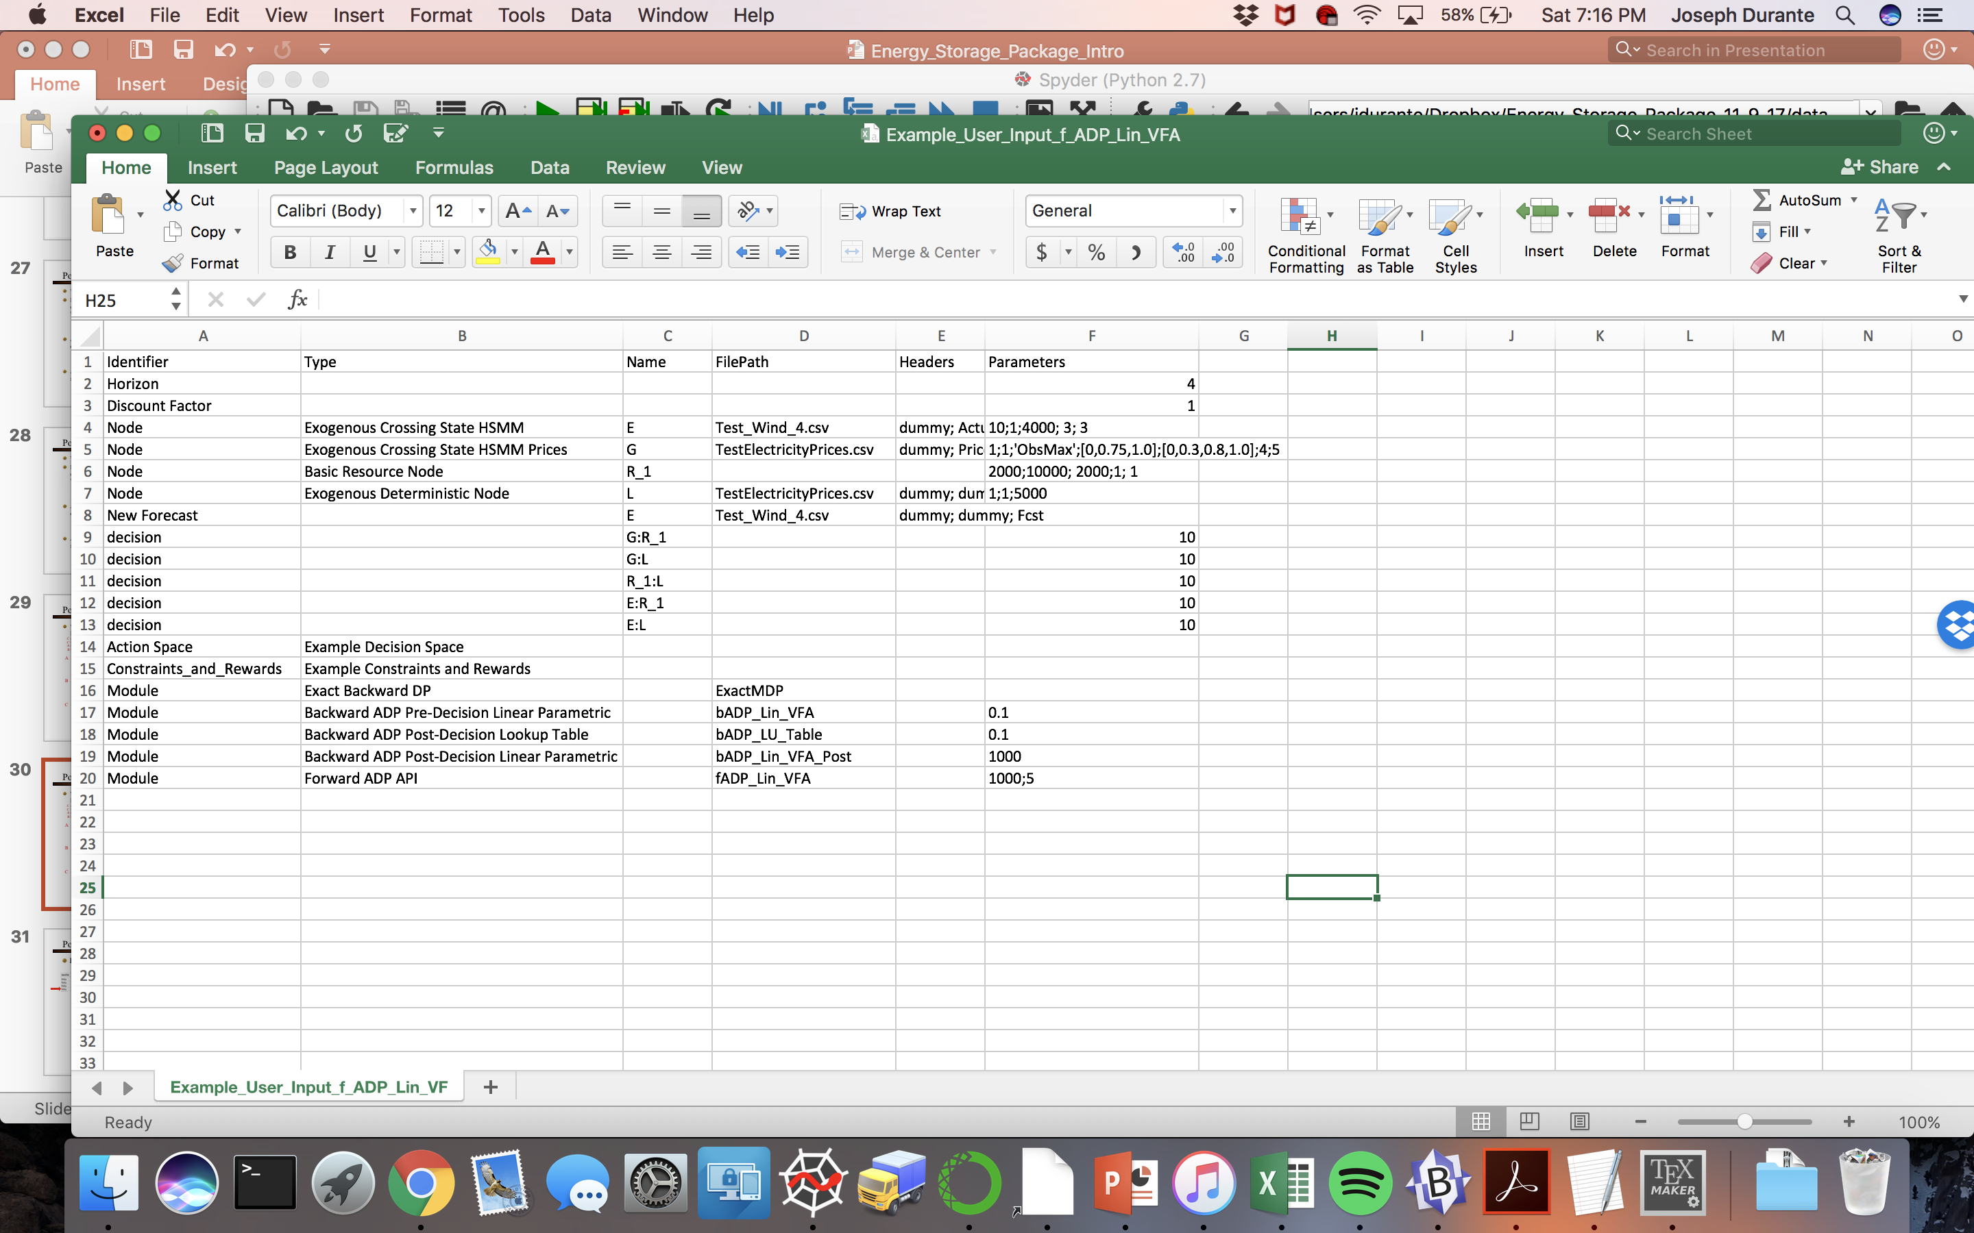
Policies
VFAs: Five algorithms available for fitting different VFA types
Linear model (linear in the parameters) for pre-decision states
Backward ADP algorithm that fits a linear model to sampled pre-decision states
Lookup table for post-decision states
Solve Full MDP, store post-decision state values in lookup table
Backward ADP algorithm that fits approximate lookup table values for post-decision states
Linear model (linear in the parameters) for post-decision states
Forward ADP algorithm, Approximate Policy Iteration
Backward ADP algorithm that fits a linear model to sample post-decision states
VFAs written to FilePath!
Notes:
${\overline{V}}_{t+1}\left(S_{t+1}\right)$ is some approximation of the value of the downstream states
${\overline{V}}_{t}^{x}\left(S_{t}^{x}\right)$ serves as an approximation of $𝔼\left[V_{t+1}^{∗}\left(S_{t+1}\right) | S_{t},x_{t}\right]$

Slide 32
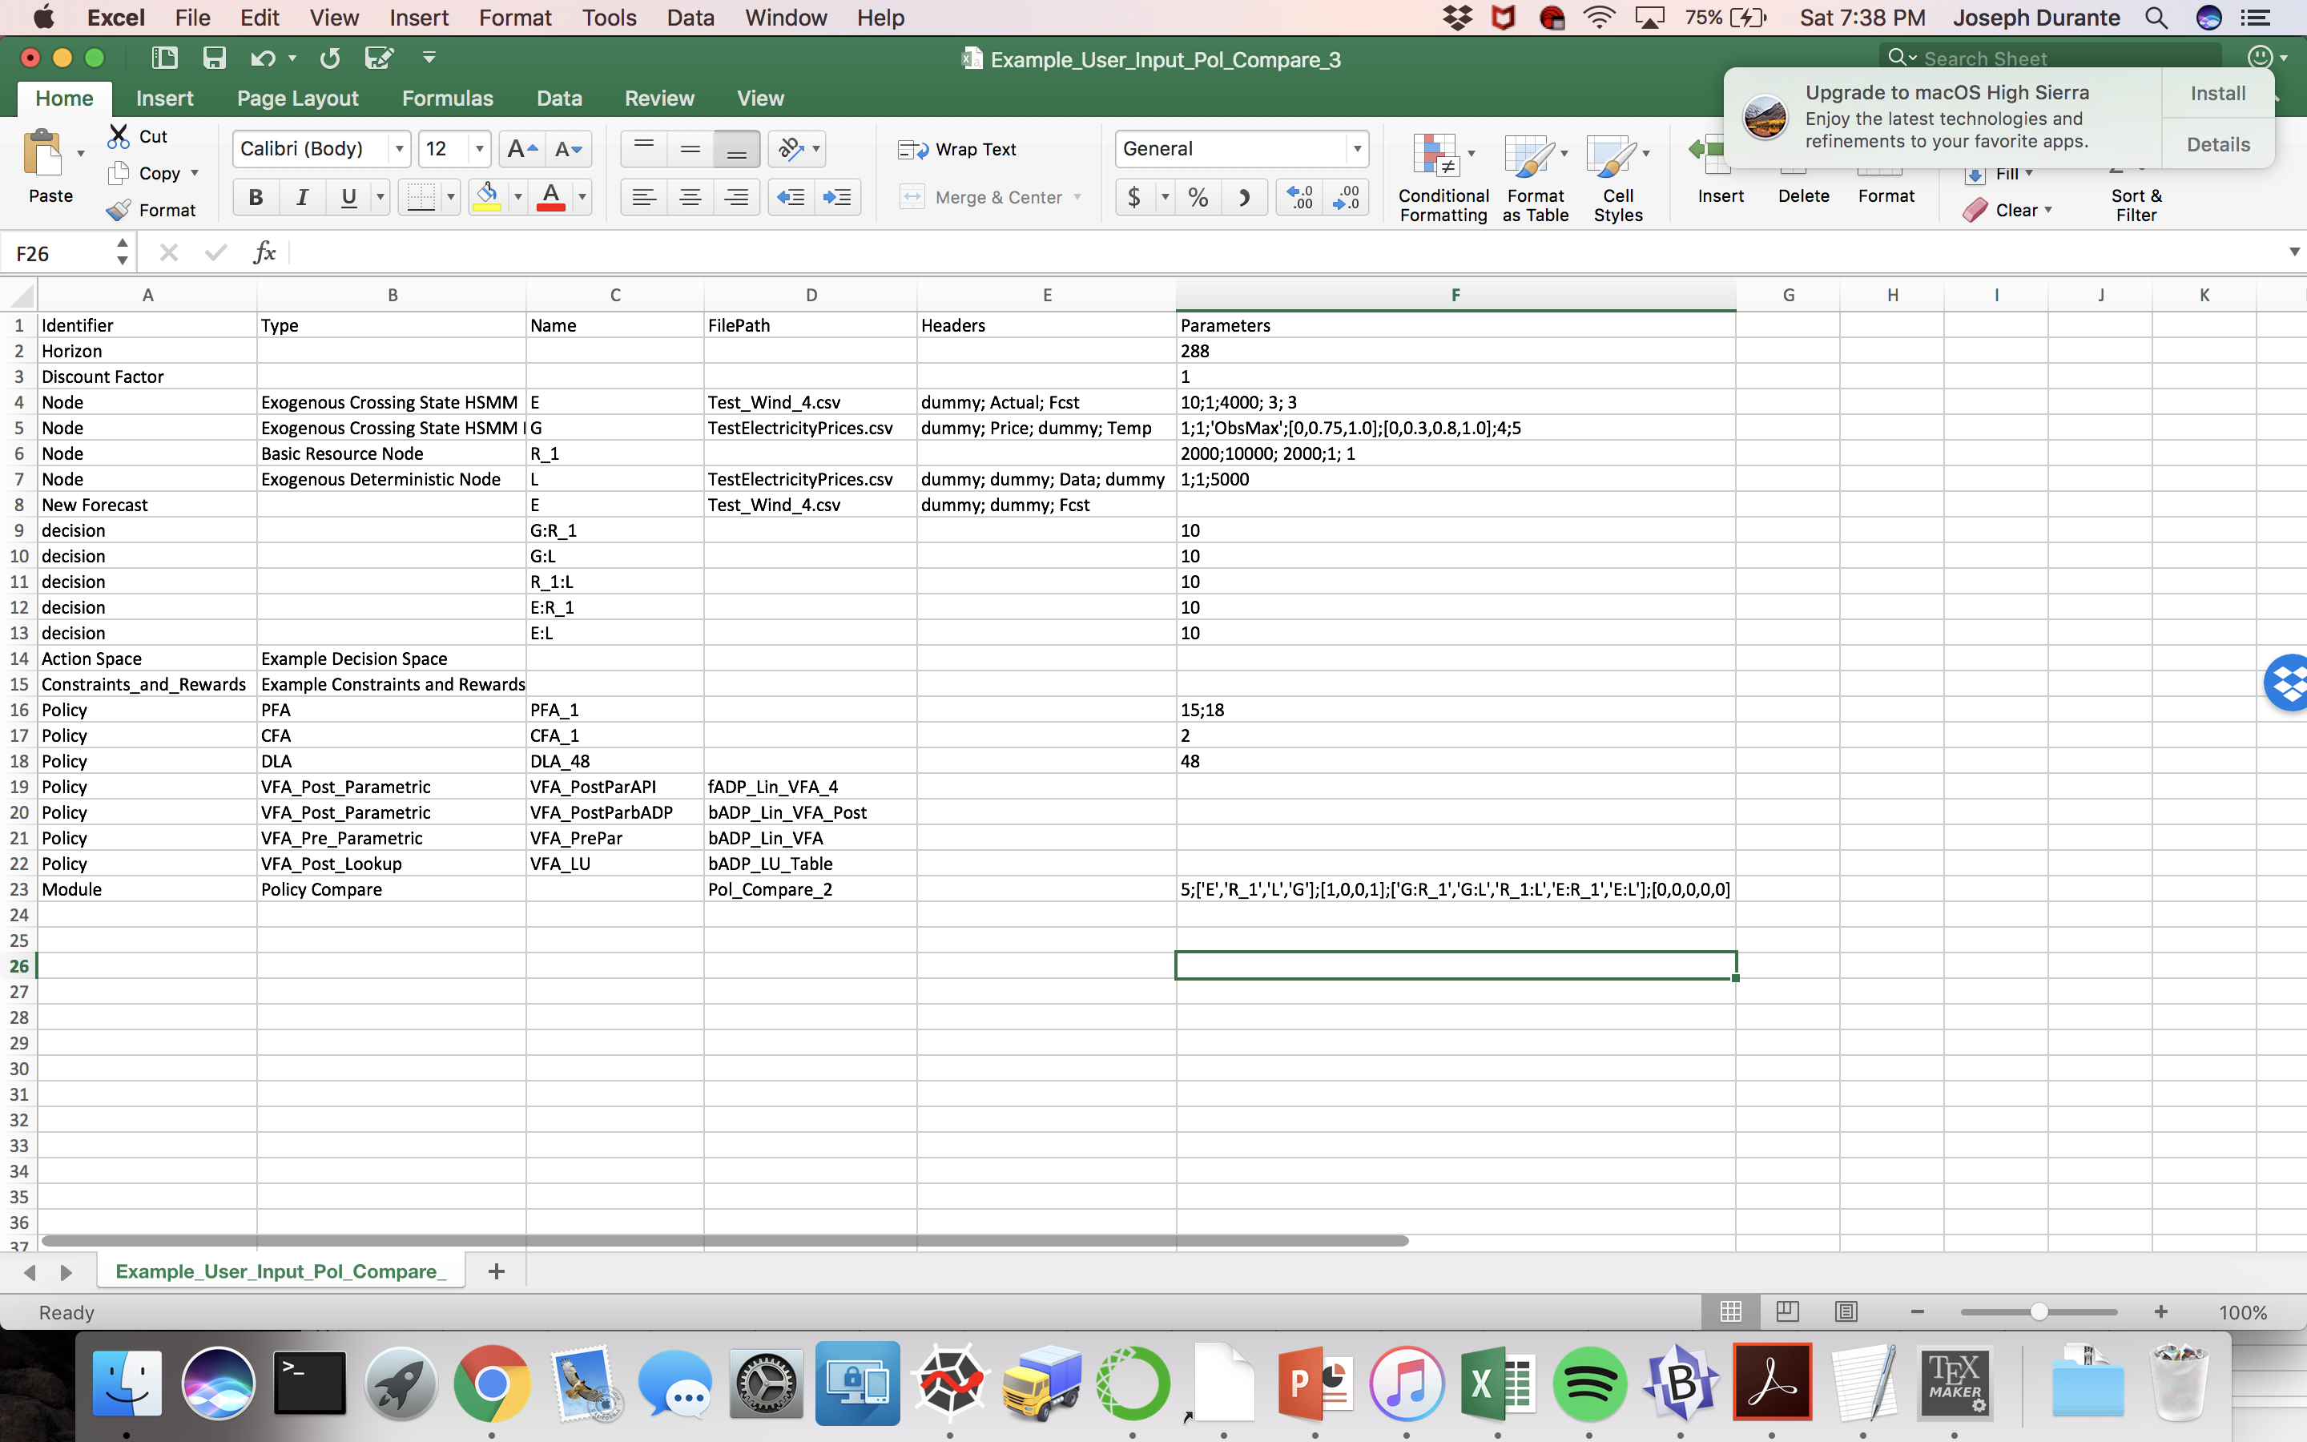
Policy Comparison
All policies tested over a common set of sample paths for exogenous information. Results are output to a text file.
Custom plotting commands entered in Excel file, plotting nodes or decisions on average (0) or for each sample path (1) for each policy; rewards earned by each policy at each time step also plotted

